Slide 1
Flight Ticket Price Prediction
Detailed Project Report
Varun Salunkhe
Sourabh Hawale
Saurabh Jumnalkar
iNeuron

Slide 2
PROJECT DETAIL
Project Title | Mushroom Classification
Technology | Machine Learning Technology
Domain | Agriculture
Project Difficulty level | Intermediate
Programming Language Used | Python
Tools Used | Jupyter Notebook, Vscode, GitHub,MongoDB compass

Slide 3
OBJECTIVE
The main goal is to predicting the fare price of a flight ticket.

Slide 4
PROBLEM STATEMENT
For purchasing an airplane ticket, the traditional purchase approach is to buy a ticket far
in advance of the flight’s departure date to avoid the risk that the price may increase
quickly before the date of departure. However, this is not always the case; if airline
corporations wish to increase sales, they can lower prices. Airlines employ a variety of
factors to decide flight ticket rates, including whether the trip is around the holidays, the
quantity of available seats on the plane, and even the month. Some of the variables can
be seen, while others are hidden. In this context, customers are attempting to discover
the best day to purchase a ticket, while airline firms, on the other hand, are attempting to
maximize overall revenue.

Slide 5
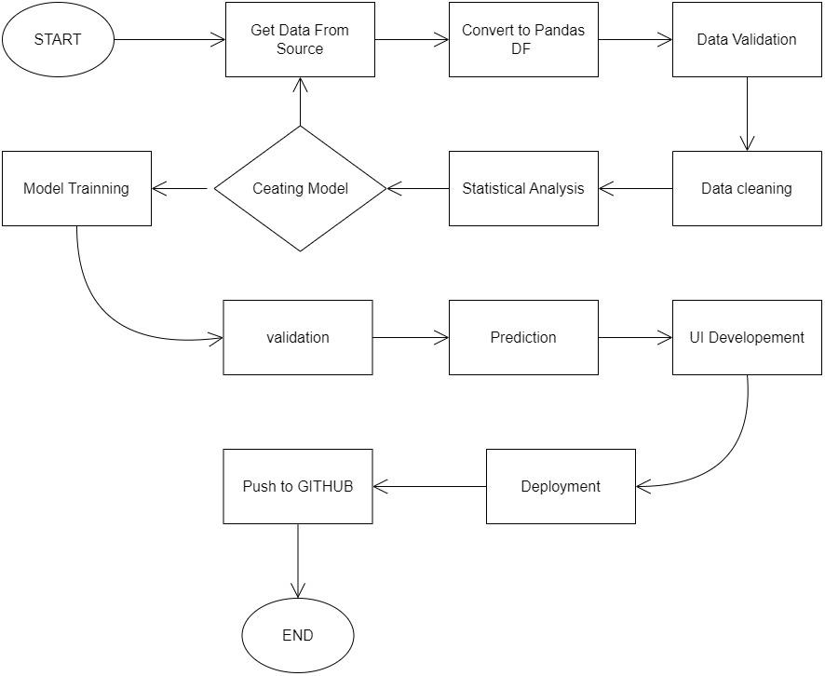
ARCHITECTURE

Slide 6
DATASET INFORMATION
Size of test set: 2671 records
FEATURES: Airline: The name of the airline.
Date_of_Journey: The date of the journey
Source: The source from which the service begins.
Destination: The destination where the service ends.
Route: The route taken by the flight to reach the destination.
Dep_Time: The time when the journey starts from the source.
Arrival_Time: Time of arrival at the destination.
Duration: Total duration of the flight.
Total_Stops: Total stops between the source and destination.
Additional_Info: Additional information about the flight
Price: The price of the ticket

Slide 7
KEY PERFORMANCE INDICATOR (KPI)
Thus, by using the Wrapper method and Filter method, the Key Attributes that contributed to the better Price of flight ticket. The attributes that have been found to be the best ones from both the attribute selection methods are compared. It is found that both the attribute selection methods almost gave the same results as the output. Hence by using these attributes as the key attributes, there will be better accuracy in the Price of flight ticket.

Slide 8
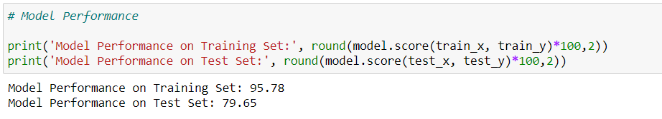
PERFORMANCE
Performance is quite good, as you can see below accuracy score for training set is 95.78% and accuracy score for test set is 79.65%.

Slide 9
CONCLUSION
This project the methods of pre-processing, steps to identify the key attributes that help in the better Price of flight ticket for a given set of travel details, like: departure date, arrival date, departure city, arrival city, stoppages, and the airline carrier.

Slide 10
THANK YOU

